Slide 1
Starting method for induction motors
Squirrel cage motors
Three-phase squirrel-cage motors are started either by connecting them directly across the line (called direct-on-line starting)
Or by applying reduced voltage (called reduced voltage starting) to the stator.
The starting method depends upon the capacity of the supply line and the type of mechanical load being driven.

Slide 2
Direct-on-line starting
The impedance of a polyphase induction motor at standstill (i.e. s =1) is relatively small and when such a machine is switched on directly to the power system, the initial current will be high and at a low-power factor.
This high low-power-factor starting current, which is about 5 to 6 times the full load current, can produce a significant voltage drop, which may affect other consumers connected to the same line.

Slide 3
Direct-on-line cont’d
Voltage sensitive devices such as incandescent lamps, television sets and high precision machine tools respond badly to such voltage dips.
The Supply Authorities protect the interest of neighbouring consumers by limiting the size of cage-motors that can be switched direct on line.

Slide 4
Direct-on-line starting cont’d
The rating of the machine depends on the capacity of the supply. In some cases the limit may be 5 kW, in others over 75 kW on a 415-V supply.
It is common to find cage motors up to 7500 kW switched direct on line because available supply system is large and 5 kW not switched direct on line.

Slide 5
Direct-on-line starting cont’d
Consult the supply authorities for motor of high ratings
This method is simple and inexpensive. It is preferred if the supply system can withstand the high low-power factor currents and the driven equipment can permit it.

Slide 6
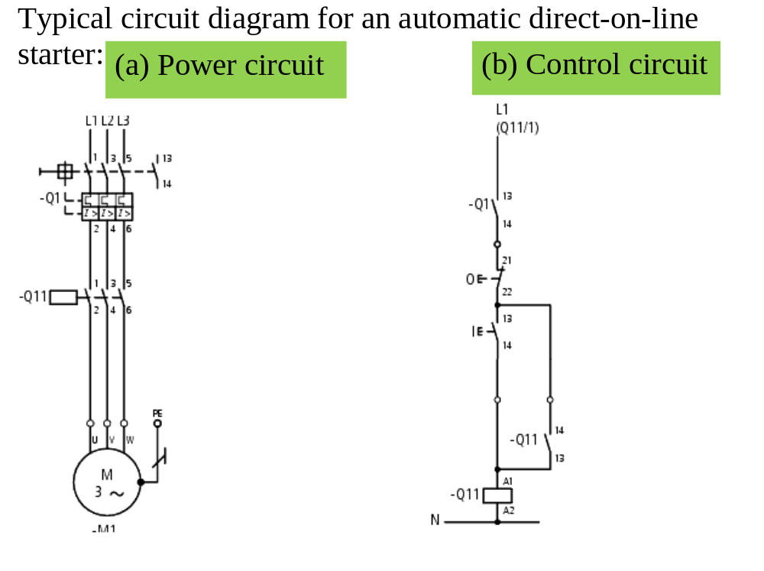

Slide 7
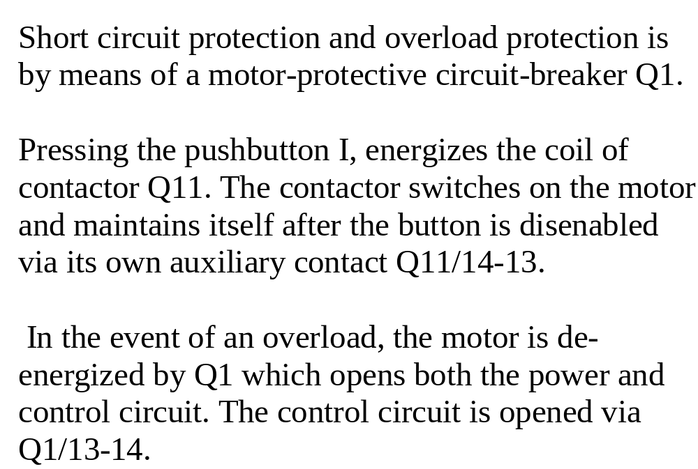

Slide 8
Reduced voltage starting
Some industrial loads have to be started very gradually. Examples are coil winders, printing press and other machines that process fragile products.
In other industrial applications a motor cannot be switched direct-on-line because the starting current is too high for the available supply system.
In all these cases reduced voltage has to be applied to the motor.

Slide 9
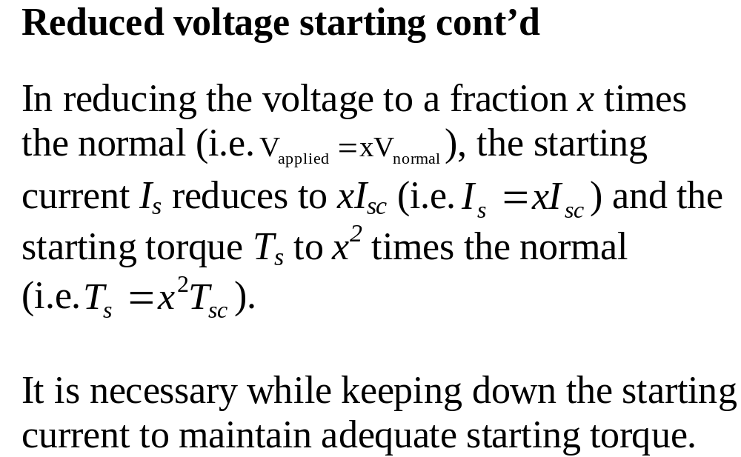

Slide 10
Methods for reduced voltage starting
Stator resistance starting
Three resistors are placed in series with the stator during the start-up period.
The resistors are short circuited after a definite time when the motor runs close to the synchronous speed (usually about 80 % of its normal speed).
The voltage drop across the resistance is high at first but gradually diminishes as the current falls.

Slide 11
Stator resistance starting cont’d
Consequently, the voltage across the motor increases with speed, and electrical and mechanical shock is negligible when full voltage is finally applied.
The resistor is short-circuited in one or several steps.
The motor is not to be started frequently otherwise the resistors can burn out.

Slide 12
Stator resistance starting cont’d
Applications: for the smooth starting of small machines such as those driving centrifugal oil purifiers.
Typical wiring diagram for automatic line resistance starter is shown on the next slide
When the start pushbutton is pressed, the start contactor coil S picks up and closes the main contacts S.

Slide 13
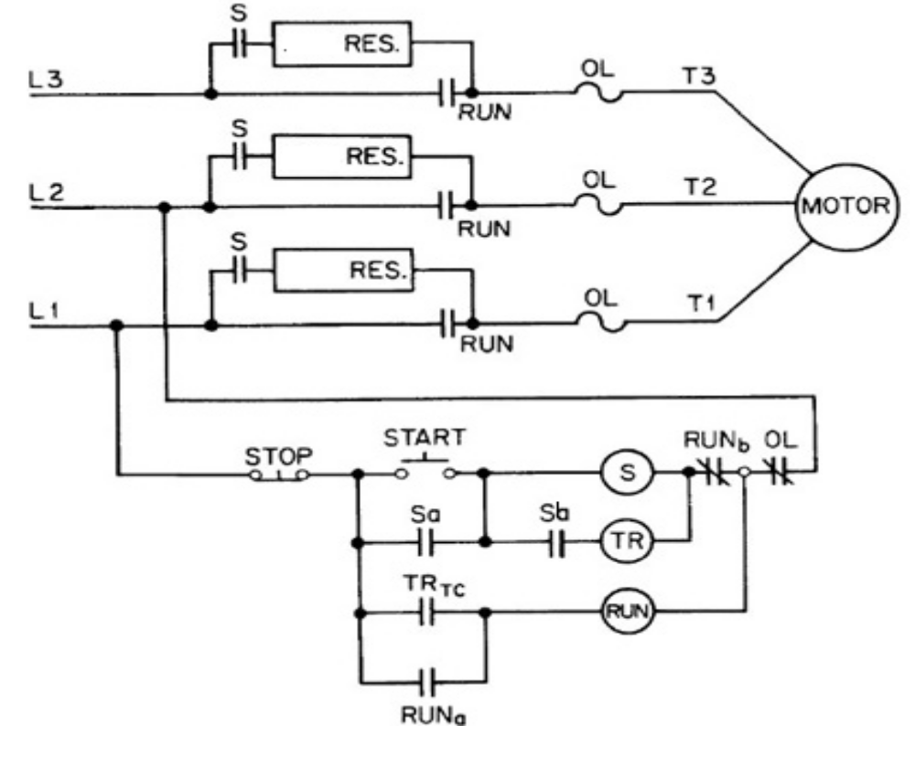

Slide 14
Stator resistance starting cont’d
The timer is also energized at the same time via auxiliary contacts S_{a} and S_{b}.
After a preset time the timer closes and through its timed contact TR_{TC} energizes the RUN contactor.
The RUN contactor when it picks up, disconnects the timing relay and the S contactor via its contact RUN_{b} and seal its coil circuit through its contact RUN_{a}.

Slide 15
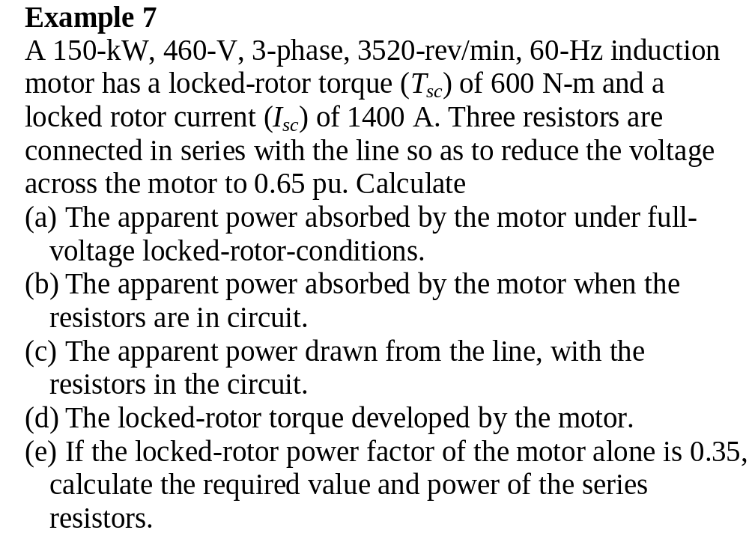

Slide 16
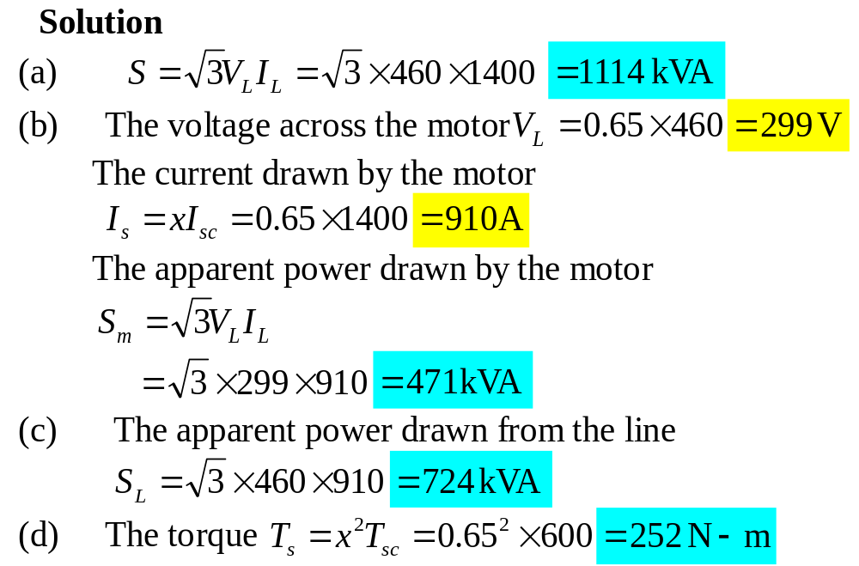

Slide 17
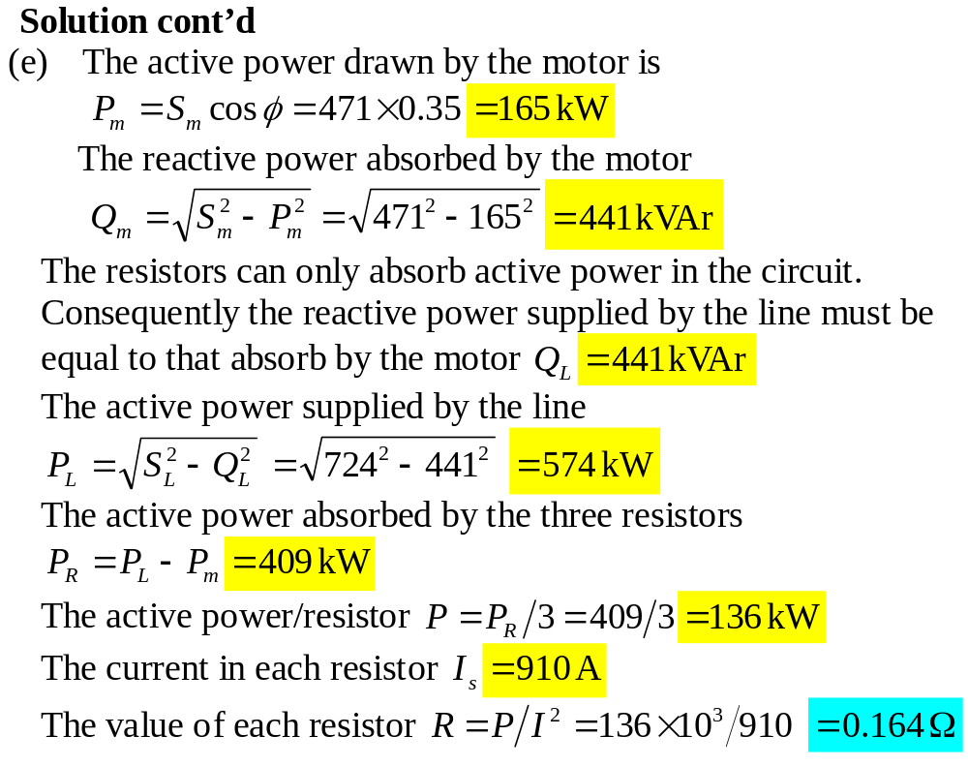

Slide 18
Autotransformer starting
Autotransformers are used to reduce the stator applied voltage.
The setting of the autotransformers can be predetermined to limit the starting current to any desired value

Slide 19
Autotransformer starting cont’d
Commercial autotransformers usually have taps to give output voltage of 0.8, 0.65, 0.5 pu.
When the motor attains about 80% of its normal speed, full line voltage is applied and the autotransformer switched out of circuit.

Slide 20
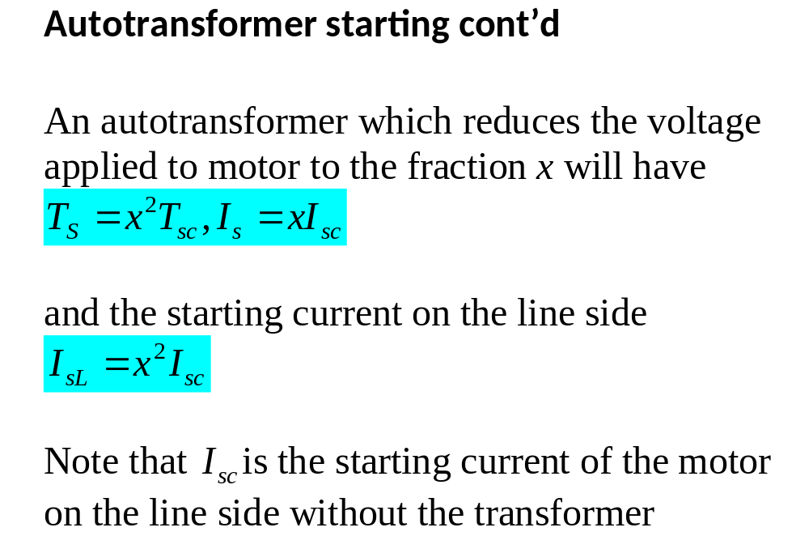

Slide 21
Autotransformer starting cont’d
For a given torque, autotransformer starting draws a lower line current and active power than resistance starting does.
The disadvantage is that the transition from reduced-voltage to full-voltage is not quite smooth.
During the change-over from the starting to the normal running condition, the motor is momentarily disconnected from the supply line.

Slide 22
Autotransformer starting cont’d
When the motor is reconnected a large transient current of extremely short duration is drawn.
This transient surge is hard on the contacts of contactors used and also produces mechanical shock.
Another disadvantage is that autotransformers cost more.

Slide 23
Autotransformer starting cont’d
Because the autotransformers and resistors operate for very short periods, they can be wound with much smaller wire than continuously rated devices.
This enables us to drastically reduce the size, weight and cost of these components.
Usually two 1-phase autotransformers connected in open delta are used.

Slide 24
Autotransformer starting cont’d
A three-phase autotransformer is considered when the motor must develop maximum torque at starting.
Typical circuit diagram for the starter using two single-phase transformers is shown on the next slide
The starter is open-circuit transition type.
It is so called because during the transition from start to run the motor is isolated from the power source.

Slide 25
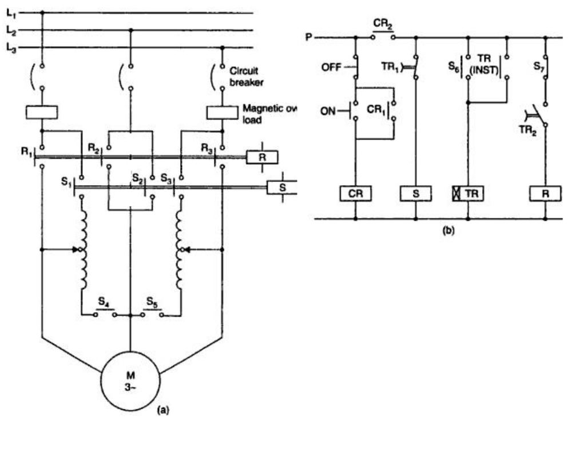

Slide 26
Pressing the ON pushbutton energizes the control relay CR
CR then gets contactor S energized through NO auxiliary contact CR₂ and NC delayed contact TR₁.
When the start contactor is energized, it connects the transformer windings to the neutral point via S4 and S5 and supplies reduced voltage from the autotransformer via S1, S2 and S3.

Slide 27
It also energizes the timer through NO contact S₆ and ensures that the R contactor coil circuit remains open while it is ON via the NC contact S₇.
The timer seals its circuit through its own instantaneous contact TR (INST).
After the pre-set time, the timer NC delayed contact TR₁ opens to de-energize the start contactor S and NO delayed contact TR₂ closes to complete the run contactor R coil circuit.

Slide 28
However, R coil is not energized until the start contactor drops out and its NC contact S₇ in the coil circuit is closed.
The motor is connected directly to the supply when the run contactor R picks up.
The control circuit is designed to ensure that contactor R and contactor S are not ON at the same time
Why?

Slide 29
Because if both are ON at the same time, circulating current will flow in the autotransformer windings between the transformer taps and the terminals connected to the supply and cause overheating of the transformer.

